Slide 1

NAVBAR
E PROJECT QUICK SNACK

Slide 2

carousel

Slide 3
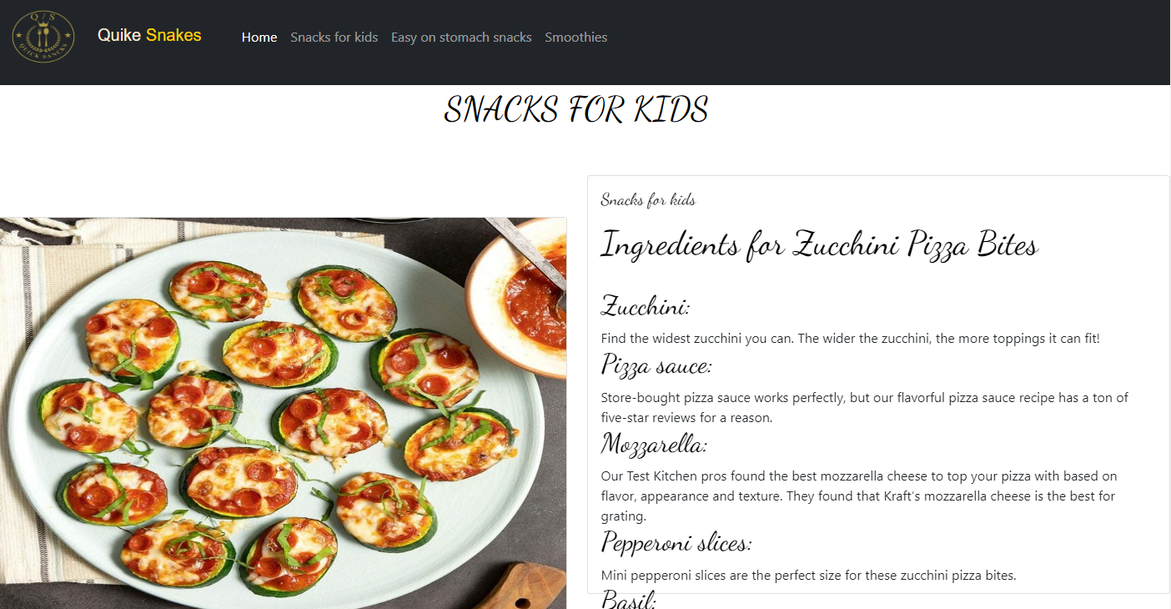
HOME PAGES

Slide 4
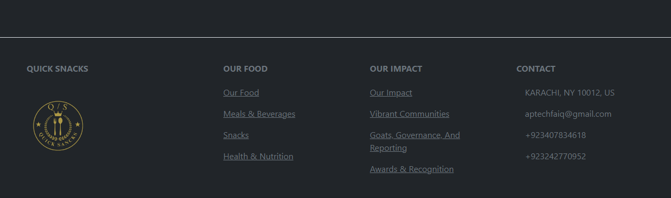
FOOTER

Slide 5
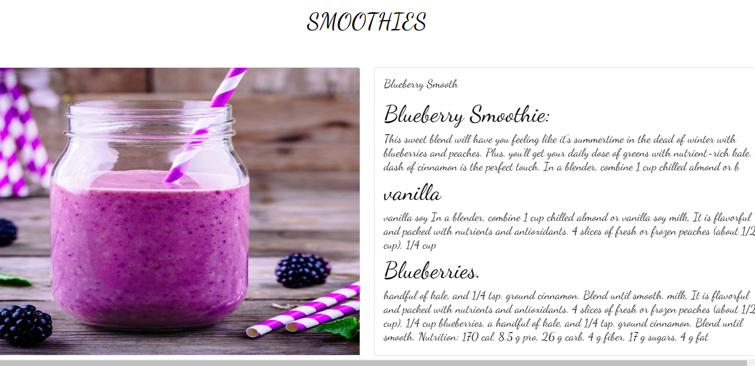
HOME PAGE

